Slide 1
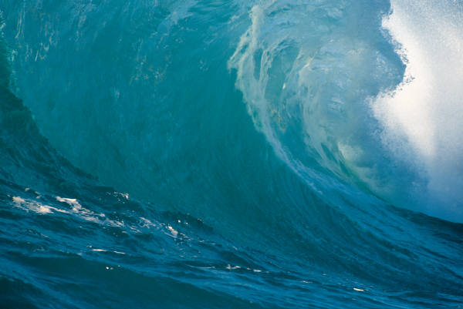
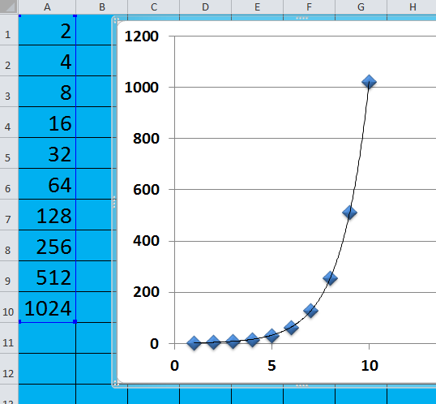
I Got the Power!
Powers and Exponents
SOL 6.5
By Kathy Woodard
2011
“Growing exponentially,
that’s how I want my money!”

Slide 2
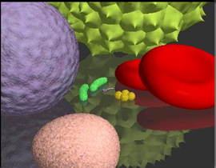
6.5 The student will investigate and describe concepts of positive exponents and perfect squares.

Slide 3

2 limbs
X 2 branches
on each
X 2 twigs
on each
= 8
Powers of 2 Tree

Slide 4

2
x 2
x 2
x 2
= 16
Powers of 2

Slide 5
exponent
base
2 to the 6th power
= 2 x 2 x 2 x 2 x 2 x 2
= 64

Slide 6

Powers of 2
1
2
2x2 = 4
2x2x2 = 8
2x2x2x2 = 16
2x2x2x2x2 = 32
2x2x2x2x2x2 = 64
2x2x2x2x2x2x2 = 128

Slide 7


2 to what power?
Powers of 2
How many bees?

Slide 8
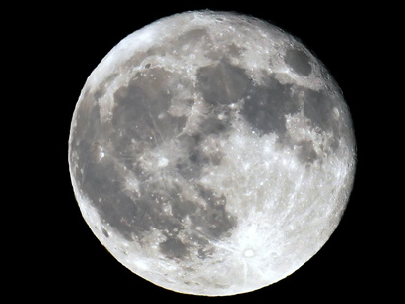

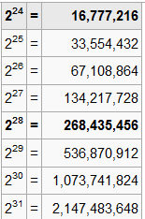
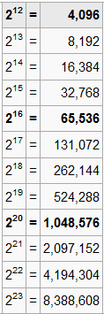
1,191,290,000 feet to the moon

Slide 9
exponent
base
Ten to the 3rd power
= 10 x 10 x 10
= 1000

Slide 10

Powers of 10
= 1
=10
=10x10 = 100
=10x10x10 = 1000
=10x10x10x10 = 10,000
=10x10x10x10x10=100,000

Slide 11
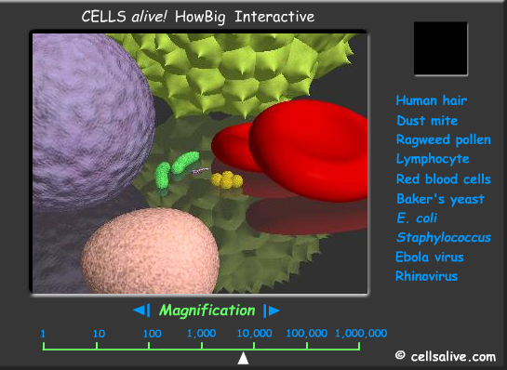
Powers of 10
http://www.cellsalive.com/howbig.htm

Slide 12
It does not equal 20
exponent
base
Five to the 4th power
= 5 x 5 x 5 x 5
= 625

Slide 13
exponent
base
Four to the 5th power
= 4x4x4x4x4
= 1024

Slide 14
exponent
base
Eight to the 6th power
=8x8x8x8x8x8
= 262,144

Slide 15
Some Powers Have Nicknames
Why?
Six to the 2nd power
Nickname: 6 Squared

Slide 16
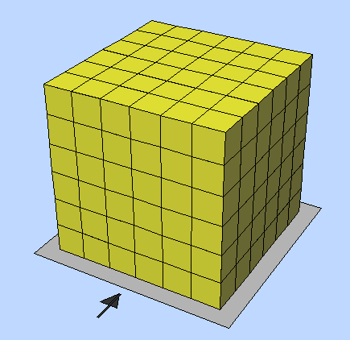
Some Powers Have Nicknames
Why?
Six to the 3rd power
Nickname: 6 Cubed

Slide 17
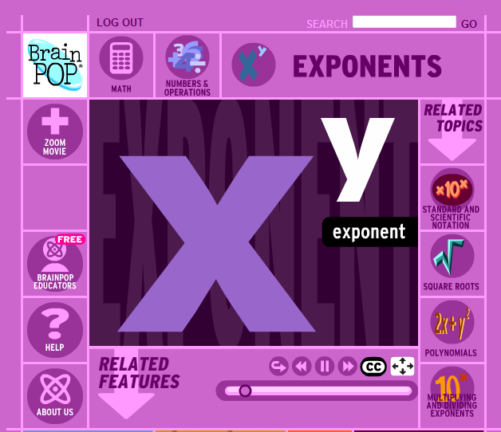
http://www.brainpop.com/math/numbersandoperations/exponents/

Slide 18
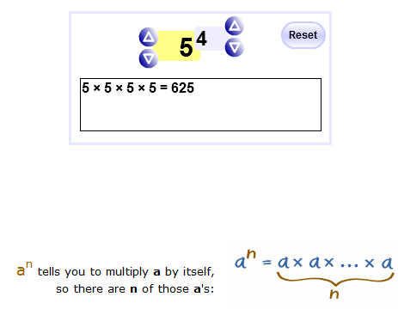
6.5 The student will investigate and describe concepts of positive exponents and perfect squares.
Number &
Number Sense
Math is Fun
This applet lets you change the base and/or exponent and immediately see the product!
http://www.mathsisfun.com/exponent.html

Slide 19
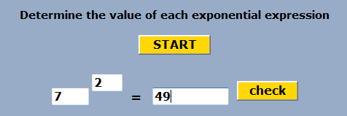
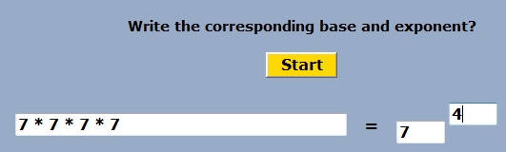
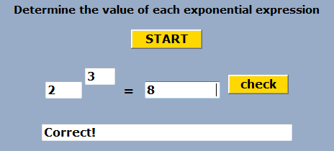
http://www.aaastudy.com/exp-eval-squ1.htm
http://www.aaastudy.com/exp-pow-by-mult.htm
Practice at AAA Math
http://www.aaastudy.com/exp-eval-exp.htm

Slide 20
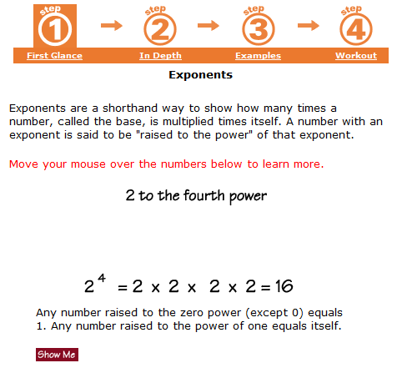
More Help at Math.com
http://www.math.com/school/subject1/lessons/S1U1L8GL.html#sm2

Slide 21
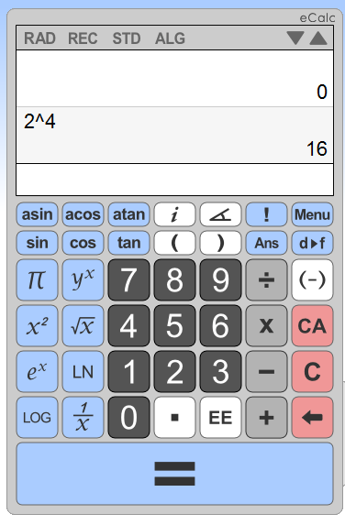
Online Calculator
http://www.ecalc.com/

Slide 22
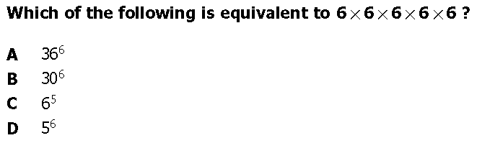
09 NS 6.5 Exponents & Perfect Squares

Slide 23
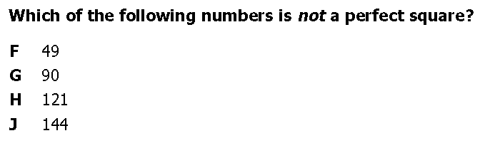
09 NS 6.5 Exponents & Perfect Squares

Slide 24
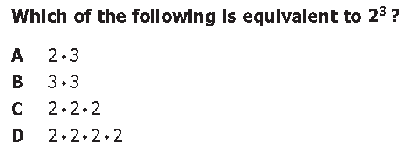
09 NS 6.5 Exponents & Perfect Squares

Slide 25
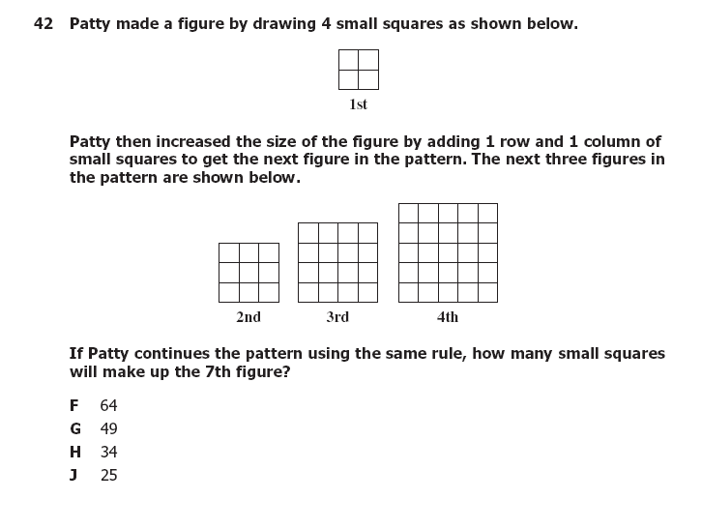
07 SOL 6.21, 22*

Slide 26
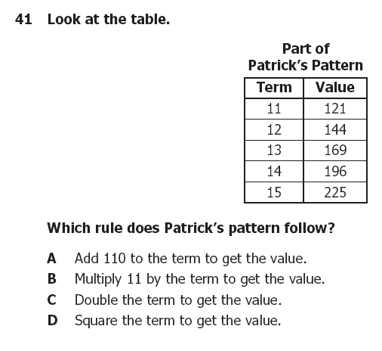
08 SOL 6.21, 6.22*

Slide 27
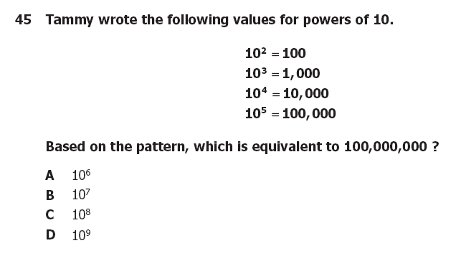
08 SOL 6.21, 6.22

Slide 28
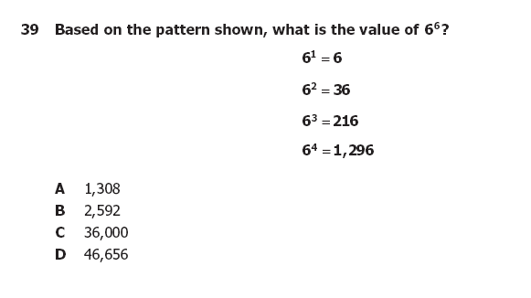
07 SOL 6.21,22*

Slide 29
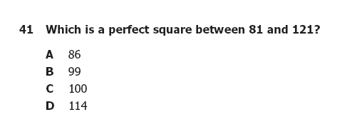
07 SOL 6.22*

Slide 30
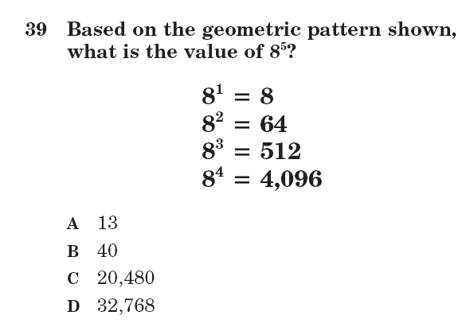
06 SOL 6.21 & 22

Slide 31
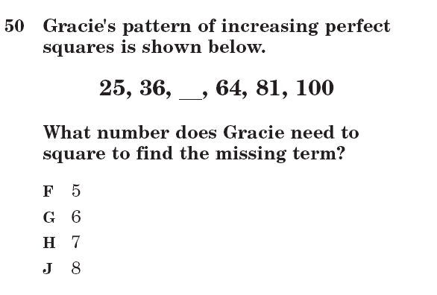
06 SOL 6.22

Slide 32
Warm-up
Circle the integers: 0 - 5.83 - 75 999 1 ½ - 0.5
Order from least to greatest: - 30, 500, - 3, - 300, 378
On the back of your paper, draw a picture of the square shown by:
Write the next 3 terms of the Sequence | Type of Pattern | Rule
100, 88, 76, 64 , ______, ______, ______
1.5, 2.8, 4.1, 5.4, _______, ______, _______
9, 16, 25, 36, _______, _______, ________
32, 64, 128, 256, _______, _______, ______
Exponent | Words | Product | Value
 | 13 squared
 |  | 2x2x2

Slide 33
Homework
Circle the integers: - 6/7 - 290 25.3 -11 0 27
Order from least to greatest: 56, 19, -23, 28, -78, -5
On the back of your paper, draw a picture of the square shown by:
Write the next 3 terms of the Sequence | Type of Pattern | Rule
1, 4, 9, 16, ______, ________, ________
1, 4, 16, 64, _______, ________, _______
1, 4, 7, 10, _______, _______, ________
32, 16, 8, 4, _______, _______, ________
Exponent | Words | Product | Value
 | Seven squared
 |  | 10x10x10

Slide 34
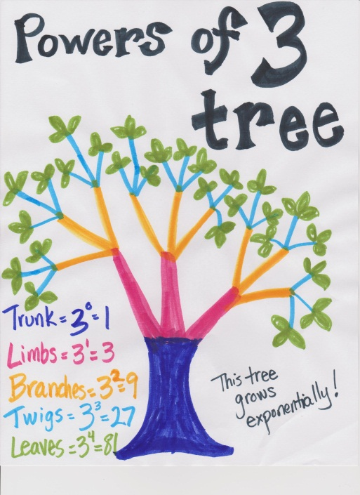
Homework
Make a Power of 3 Tree
Directions:
Draw a purple tree trunk.
Draw 3 red limbs growing out of the trunk.
Draw 3 yellow branches growing out of each limb.
Draw 3 blue twigs growing out of each branch.
Draw 3 green leaves growing out of each twig.
How many of each? Finish this chart about your tree.
Tree Part | Product | Exponent | Value
Trunk | 1 |  | 1
Limbs
Branches | 3x3 |  | 9
Twigs
Leaves

Slide 35


