Slide 1
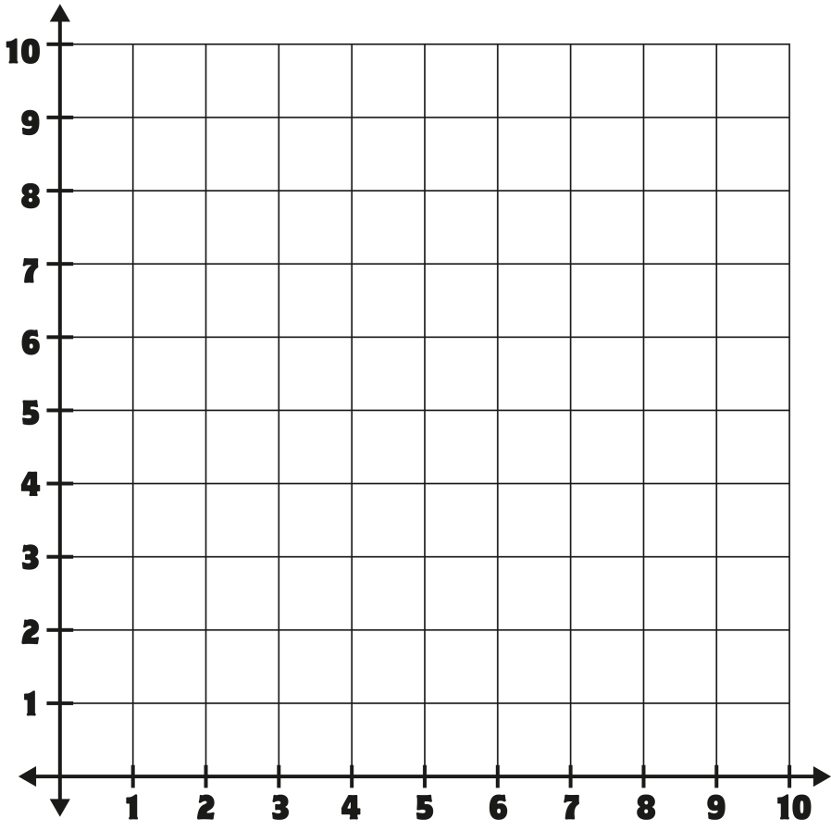
Coordinate Plane Game
(1,4)
(9,8)
(3,5)
(7,6)
(0,10)
(2,0)
(8.1)
(4,7)

Slide 3
Question Board
Question
1
Question
2
Question
3
Question
4
Question
5
Question
6
Question
7
Question
8
Question
9
Question
10
Question
11
Question
12
Question
13
Question
14
Question
15
Question
16
Question
17
Question
18
Question
19
Question
20
Question
21
Question
22
Question
23
Question
24
Question
25
Team A
Team B
Team C
Team D

Slide 4
1
Square?
(3,9)
Answer

Slide 5
2
Hexgaon?
(6,8)
Answer

Slide 6
3
Star?
(7,1)
Answer

Slide 7
4
Circle?
(1,2)
Answer

Slide 8
5
Pentagon?
(8,6)
Answer

Slide 9
6
(3,5)
Answer

Slide 10
7
(9,9)
Answer

Slide 11
8
(5,7)
Answer

Slide 12
9
(6,3)
Answer

Slide 13
10
(4,1)
Answer

Slide 14
11
White peep?
(2,2)
Answer

Slide 15
12
Orange peep?
(8,7)
Answer

Slide 16
13
Blue peep?
(4,10)
Answer

Slide 17
14
Yellow peep?
(2,7)
Answer

Slide 18
15
Purple peep?
(5,5)
Answer

Slide 19
16
(10,5)
Answer

Slide 20
17
(2,9)
Answer

Slide 21
18
(6,0)
Answer

Slide 22
19
(8,10)
Answer

Slide 23
20
(1,1)
Answer

Slide 24
21
red peep?
(2,9)
Answer

Slide 25
22
Pink peep?
(8,4)
Answer

Slide 26
23
Green peep?
(3,1)
Answer

Slide 27
24
yellow peep?
(0,6)
Answer

Slide 28
25
Purple peep?
(5,5)
Answer

